Slide 1


DECARBONIZATION
Ali, Eve, Melvin

Slide 2

Project focuses on achieveing a net zero carbon economy. This is by decarbonization which refers to the process of reducing carbon dioxide (CO₂) and other greenhouse gas (GHG) emissions, primarily by transitioning from fossil fuels to cleaner energy sources like renewables (e.g., wind, solar, hydroelectric power) and improving energy efficiency.

Slide 3

Variables of focus.
1.Date
Description: The time period (e.g., month or year) corresponding to each data point.
•2.Energy_Consumption_kWh
Description: Total energy consumption measured in kilowatt-hours (kWh).
Provides insights into the scale of energy use, helping identify patterns or inefficiencies in energy-intensive industries or regions.
3.Renewable_Energy_Share_%
Description: The percentage of total energy consumption derived from renewable sources (e.g., wind, solar, hydropower).
Measures progress toward cleaner energy systems.
High renewable energy share indicates reduced dependency on fossil fuels and lower carbon emissions.

Slide 4

4.Carbon_Emissions_tCO2
Description: Total carbon emissions measured in metric tons of CO₂ (tCO₂).
The primary indicator of progress toward decarbonization.
Used to assess the environmental impact of energy consumption and production activities.
5.Scope_1_Emissions_tCO2
Description: Direct emissions from owned or controlled sources, such as manufacturing processes or company-owned vehicles.
Highlights the direct carbon footprint of organizations, enabling targeted reduction strategies.
Critical for identifying emission hotspots in production and operations.
6.Scope_2_Emissions_tCO2
Indirect emissions from the generation of purchased electricity, steam, heating, or cooling.
Allows assessment of emissions linked to energy consumption choices (e.g., grid dependency vs. renewables).
Provides insights for transitioning to cleaner energy sources.

Slide 5
7.Scope_3_Emissions_tCO2
Description: Emissions from all other activities along the value chain, including supply chain, transportation, and product use.
Offers a holistic view of an organization’s carbon footprint, beyond direct and energy-related emissions.
Highlights opportunities for decarbonization in supply chain management and logistics.
8.Carbon_Cost_per_tCO2
Description: The cost incurred for every ton of CO₂ emitted, based on carbon pricing mechanisms such as taxes or emissions trading.
Links financial implications to carbon emissions, encouraging businesses to reduce emissions to lower costs.
A useful metric for cost-benefit analysis of decarbonization initiatives.
•

Slide 6
9. Waste_Generated_tons
Description: Total waste generated in tons during production or consumption processes.
Relevance: Strongly correlated with energy inefficiencies and emission-intensive practices.
Helps assess the sustainability of resource use and waste management practices.
10. Production_Units
Description: The total number of goods or services produced in a given time period.
Relevance:Enables normalization of energy consumption and emissions data (e.g., emissions per unit produced).
Useful for benchmarking industries and identifying best practices for energy-efficient production.
Simulated data with out target variable being emission of co2 in tons ,energy consumption and carbon pricing

Slide 7
DATA CLEANING
This is the process of identifying any issues in the dataset that could affect the analysis. This involves dealing with missing values, outliers, and inconsistencies.
Data for this project was synthetic hence there are no missing values.
Outliers were identified using statistical methods by calculating values that are far above and below the mean.They removed to a reasonable range so as not to interfere with the model.
Inconsistency-The data may contain negative values that do not make sense or extremely large numbers. This is issue was corrected and replaced with appropriate numbers

Slide 8
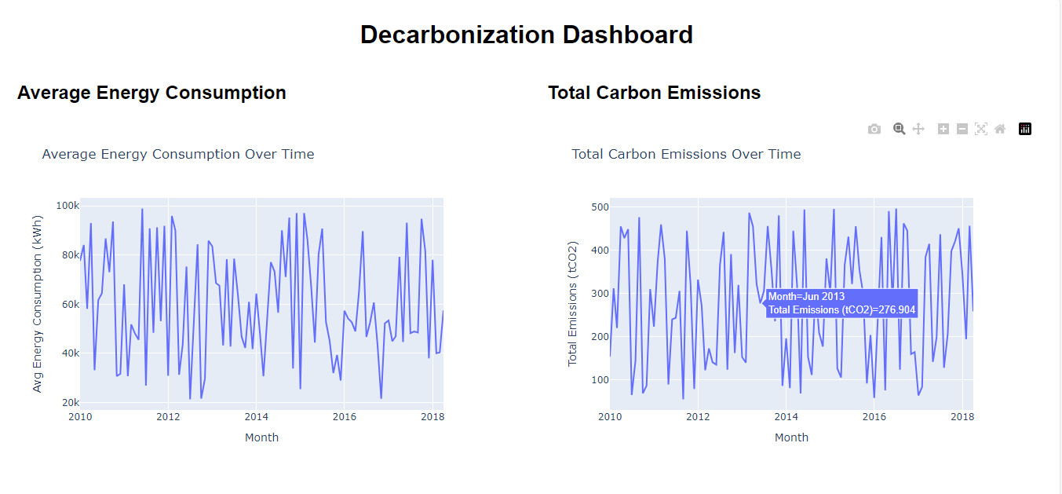

Slide 9
This is a dashboard visualizing the relationship of average energy consumption and total carbon emission over time .
Trends in Energy Consumption:
• Increasing Energy Consumption: If the average energy consumption is rising over time, it suggests that the demand for energy is increasing. This could be due to population growth, industrial expansion, or a shift toward more energy-intensive technologies.
• Decreasing or Stable Energy Consumption: A steady or decreasing trend in energy consumption could indicate that energy efficiency measures are being implemented successfully, or that energy usage is being optimized due to advances in technology or energy-saving practices.

Slide 10
Trends in Carbon Emissions:
• Increasing Carbon Emissions: If carbon emissions are rising over time, it typically means that energy consumption is increasing without a corresponding reduction in the carbon intensity of the energy used. This could happen if fossil fuels (which are more carbon-intensive) are the main energy source.
• Decreasing or Stabilizing Carbon Emissions: A decline or stabilization in carbon emissions might indicate a shift towards cleaner energy sources (e.g., solar, wind), improved energy efficiency, or better emission control technologies. This could be a sign of progress in decarbonization efforts.

Slide 11
Energy efficiency and carbon Intensity
• Energy Efficiency: If energy consumption increases but carbon emissions remain stable or decrease, it may suggest improvements in energy efficiency. For instance, industries or cities might be consuming more energy but doing so in a way that reduces their carbon footprint (e.g., through energy-efficient appliances or buildings).
• Carbon Intensity: If both energy consumption and carbon emissions rise at the same rate, it suggests that the energy mix remains heavily dependent on fossil fuels. Conversely, if energy consumption increases but emissions stay low, it suggests that the energy mix is becoming cleaner (e.g., a higher share of renewable energy sources).

Slide 12
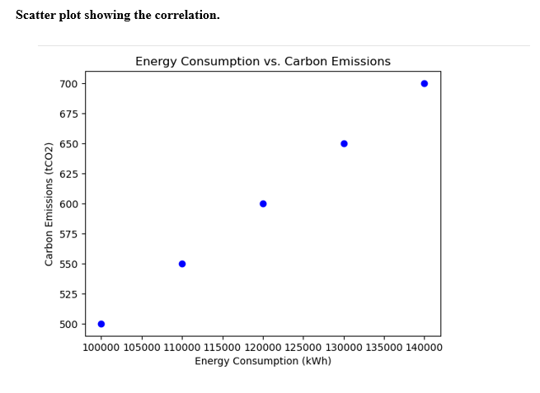

Slide 13
Feature Engineering
Feature engineering is the process of transforming existing ones to improve the predictive power of models.
• Carbon Intensity: A new feature, carbon intensity, was created by dividing carbon emissions by energy consumption (e.g., CO₂ emissions per kWh). This helps understand how efficiently energy is being used and whether a higher share of renewable energy reduces carbon intensity.
• Renewable Energy Growth: The difference in renewable energy share from one period to the next was calculated. This feature

Slide 14
PREDICTIVE MODELS
1. Model choice.
Selected Model: Random Forest Regressor
Reason:
Handles both linear and non-linear relationships between variables, making it suitable for complex decarbonization data.
Robust to overfitting when hyperparameters are tuned.
Provides feature importance, helping identify key drivers of carbon emissions.

Slide 15
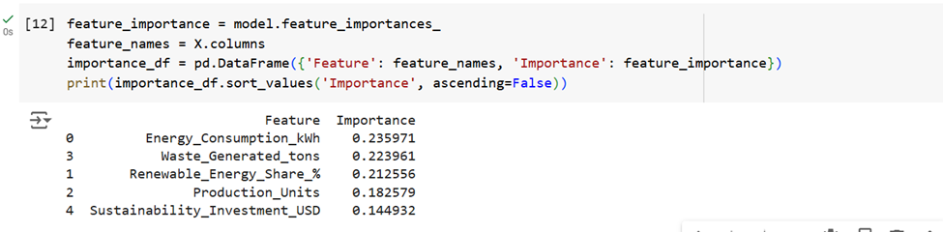
RMSE: 135.66
R² Score: -0.19
To calculate the root mean squared error, use the function'root_mean_squared_error'.
warnings.warn(
4.Results
RMSE: 135.66
R² Score: -0.19
An RMSE of 135.66 suggests the model's predictions deviate significantly from the true carbon emissions, indicating poor accuracy.
A n R² of -0.19 suggests that the model fails to capture the relationship between the features and the target variable.

Slide 16
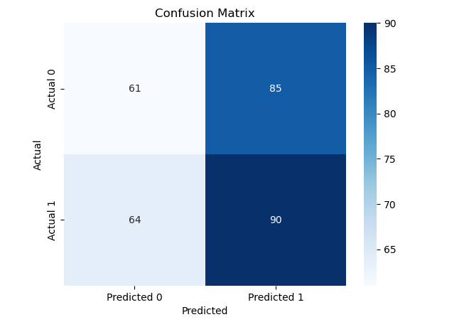

Slide 17
BUSINESS IMPLICATIONS.
1. Operational Decisions:
o By predicting whether a company will achieve its carbon reduction targets, businesses can better allocate resources to areas that will likely yield the most significant reductions. For example, if a company’s energy consumption is found to be a strong predictor of carbon reduction success, efforts can be made to optimize energy use and increase the share of renewable energy.
2. Strategic Planning:
o The model can assist companies in setting realistic carbon reduction goals. By understanding which factors are most influential in achieving carbon reductions, businesses can focus their efforts on improving those aspects of their operations. For instance, investing in renewable energy technologies or improving energy efficiency in production could directly contribute to higher chances of carbon reduction success.

Slide 18
3. Regulatory Compliance:
o Many industries face increasing regulatory pressure to meet sustainability and carbon reduction targets. This model can help businesses predict their ability to meet such targets, thus assisting in strategic planning and ensuring compliance with environmental regulations. Predicting the likelihood of achieving carbon reduction goals could also help businesses prepare for future regulations or carbon pricing mechanisms
4. Investment Decisions:
o Investors increasingly seek businesses that are committed to sustainability and reducing their carbon footprints. By using predictive models like this one, companies can demonstrate to investors that they are on track to meet their carbon reduction goals, which could potentially lead to more favorable investment conditions.

Slide 19
LIMITATION.
1. Data Quality and Size:
o The dataset used for training the model was relatively small in the initial stages. A larger, more diverse dataset with more examples of both successful and unsuccessful carbon reduction initiatives would likely improve the model's performance. Additionally, the dataset may not cover all possible scenarios and variables influencing carbon reduction.
2. Feature Selection:
The features used in the analysis (e.g., Energy_Consumption_kWh, Renewable_Energy_Share_%) are just a small subset of the potential variables that could impact carbon reduction success. More features, such as carbon emissions, production efficiency, or waste generation, could provide a better understanding of the factors influencing decarbonization efforts

Slide 20
CARBON PRICING PROMPT
Based on the findings from the decarbonization dataset and carbon pricing calculations, the following actionable recommendations are suggested
1. Incentivize Renewable Energy Integration:
o Renewable energy sources can significantly reduce carbon emissions. By improving the share of renewable energy in energy consumption, companies and governments can drive down both emissions and associated carbon costs.
2.The calculated carbon pricing can guide policy decisions. Governments and companies should integrate carbon pricing mechanisms (e.g., carbon tax or carbon markets) to hold industries accountable for their emissions.
3. Energy Efficiency Programs:
o Promoting energy efficiency not only reduces energy consumption but also lowers the associated carbon emissions and costs.

Slide 21
FUTURE RECOMMENDATIONS
Real-Time Data Analysis and Decision-Making:
• AI could be used to analyze real-time data from various sources (e.g., sensors, smart grids, energy consumption databases) to provide immediate feedback on emissions and suggest real-time actions to minimize carbon footprints. This would be particularly useful in industries where emissions fluctuate throughout the day, such as manufacturing or energy production.

Slide 22
MAIN QUEST
In conclusion
The purpose of this project was to analyze decarbonization efforts in the context of achieving a net-zero carbon economy. By leveraging a simulated decarbonization dataset, we explored key factors such as energy consumption, carbon emissions, and carbon cost per ton of CO2. The goal was to understand how these variables relate to each other and how they can be used to predict carbon pricing, which can drive further decision-making in policy and industry to reduce carbon emissions leading to a net zero carbon economy.

Slide 23
THANK YOU!

